Slide 1
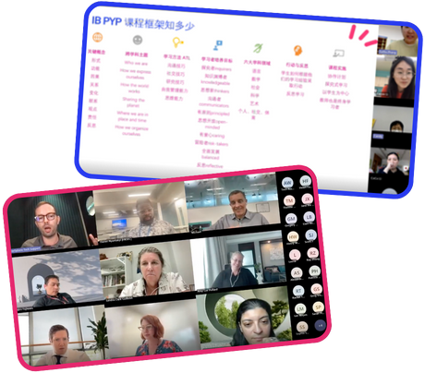
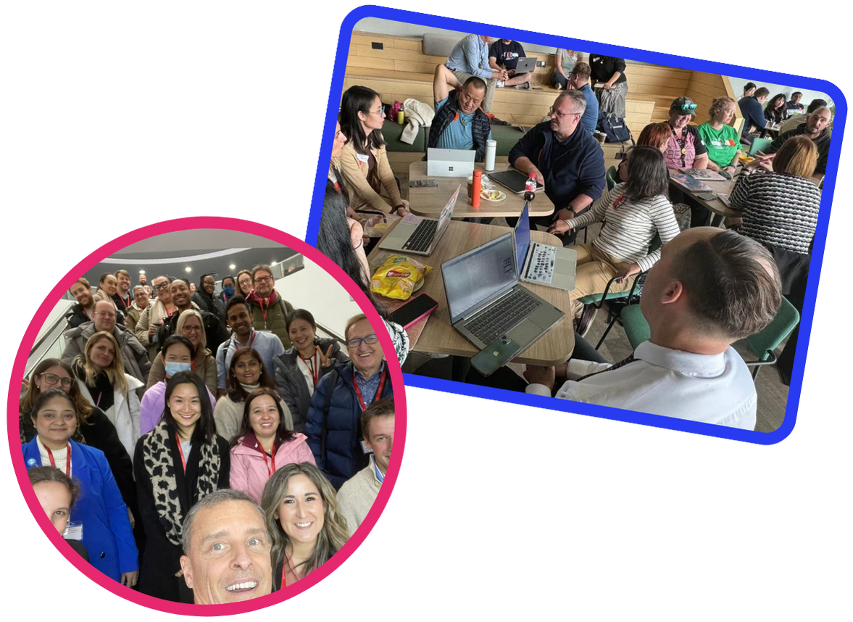
PeerSphere
Harnessing the Power of Collaborative Communities.
Give a little, gain a lot with PeerSphere
VERSION 2
© PeerSphere 2024
Notes:
SLIDE 1: Welcome
Harnessing the Power of Collaborative Communities – Peer Sphere believes that when educators connect, share, and innovate together, the entire education landscape transforms.
This slide deck is a recommended optional resource for School Account Managers (SAMs) to introduce PeerSphere to school staff.
It is designed to support a 60 minute in-school PD session.
The following timings and order of running are suggested and can be adjusted to fit school contexts.
As a large Group: 20 mins – Slides 1 - 13
In small Groups/Teams: 20 mins – Slides 14 onwards
Pairs/Individuals: 20 mins – Slide 18 to get started
See handbook for more detailed outline of a suggested session: https://www.peer-sphere.com/peersphere-handbook-2024-2025/
Note for Facilitator: Tailor slides 4, 9 and 18 with school specific information. In order to facilitate session delivery, you might want to:
Share a digital version of the PowerPoint slides to all staff to enable quick reference to your unique school URL and key information.
Provide copies of the PowerPoint slides printed three to a page with space for notes for each staff member.

Slide 2
We’ve joined Asia’s largest PLC for international schools
© PeerSphere 2024
Notes:
SLIDE 2: We've joined Asia's largest PLC for international schools
ACTIVITY: Present this slide with the benefits of connecting across schools in PLCs ...
PeerSphere can…
enable each of us, admin, teaching and non-teaching staff, to connect with professionals in similar roles
share about the great work we do
get some new ideas and resources from other schools
extend our professional network in the process

Slide 3
Think of ONE great professional learning experience you have had in the past. What was it and what made it great?
Discuss and identify commonalities.
© PeerSphere 2024
Notes:
SLIDE 3: Discussion Prompt
ACTIVITY: Think of ONE great professional learning experience you have had in the past. What was it and what made it great? Discuss and identify commonalities.
Talk to the person next to you
Identify commonalities about what made the PD great
Be ready to share
Note for Facilitator: Elicit points that have been heard in discussions. These will likely include some of the points below and will connect to intended professional learning experiences with PeerSphere. This will help staff buy-in.
Great professional learning is content-focused, has practical take-aways, is engaging, is fun, involves learning with others, is led by skilled facilitators, involves rich discussions, is ongoing, is supportive, has direct impact on practice…

Slide 4
Session Overview
Aims 🎯
Understand what is PeerSphere and why it matters for us
Begin to explore how PeerSphere can add value to our school, our teams and each of us as individuals
Be able to connect / set up individual accounts
Outcomes 📈
Each of us will ...
Identify ONE PeerSphere community that we want to join
Have the know how to join
Begin to get connecting with our chosen community
© PeerSphere 2024
Notes:
SLIDE 4: Session Aims and Outcomes
ACTIVITY: Present this slide. Share the session aims, outcomes alongside order of running/session timings (adjust according to school context):
As a Large Group introduction: 20 mins – Understand what is PeerSphere and why it matters for our school
In Small Groups/Teams: 20 mins – Explore how PeerSphere can add value to our school, our teams and each of us as individuals
Pairs/Individuals: 20 mins – Identify the community that excites you and have the know how to join

Slide 5
PeerSphere
We build thriving communities for international education professionals who collaborate to solve meaningful problems related to their role.
Thriving Communities
Expert
Hosts
Strategic School Partnerships
Collaborative Inquiry
© PeerSphere 2024
Notes:
SLIDE 5: PeerSphere
ACTIVITY: Present this slide with any or all of the key messages below.
PeerSphere …
Builds thriving communities for international education professionals who collaborate to solve meaningful problems related to their role.
Harnesses the power of collaborative communities to address the unique challenges faced by international school educators and administrators.
Supports professionals to not only develop but flourish through close collaboration, strategic school partnerships and expert community hosts.

Slide 6
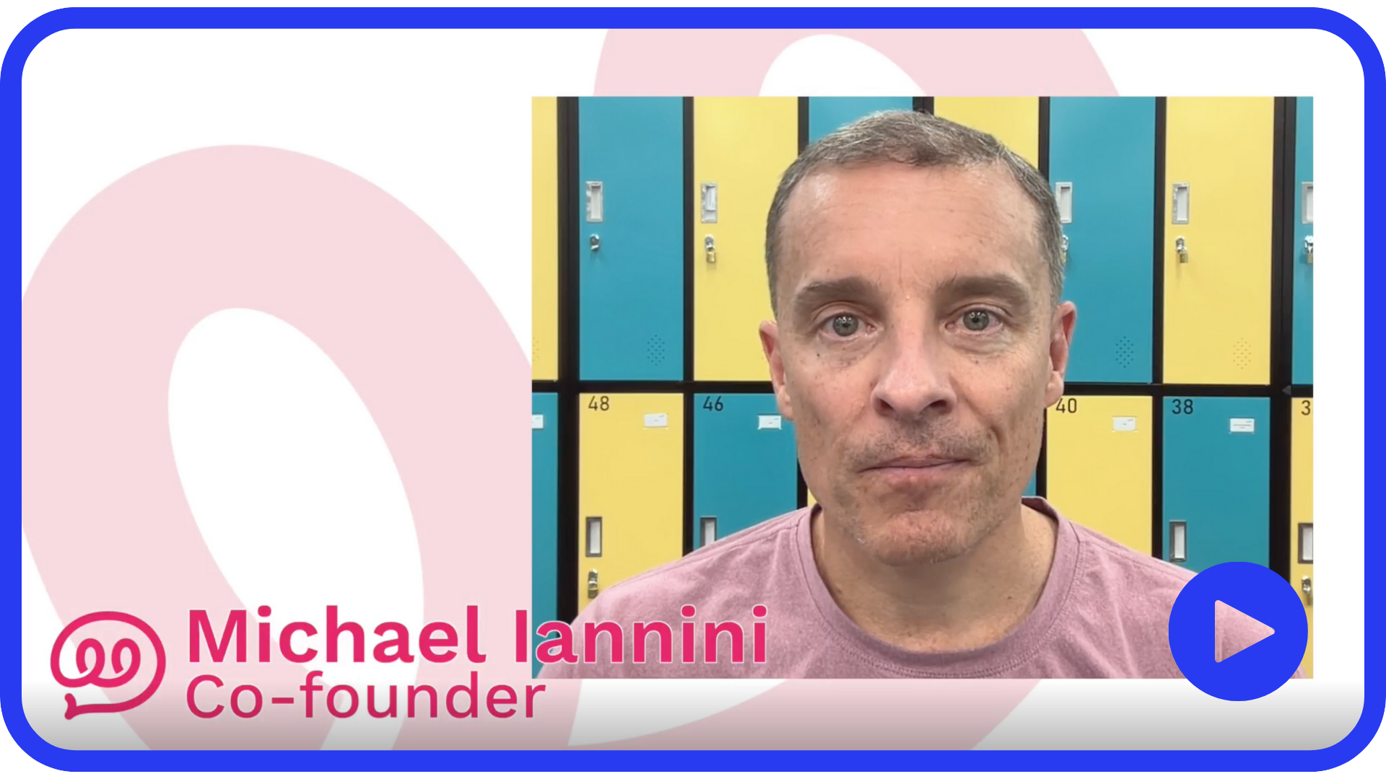
Why PeerSphere?
Click to hear from PeerSphere's Co-Founder, Michael Iannini
© PeerSphere 2024
Notes:
SLIDE 6: Why PeerSphere?
ACTIVITY: Click on the link to hear about 'Why PeerSphere?' (Video Length: 2:00)
Co-Founders Michael Iannini and Ewen Bailey are seasoned professionals with a combined experience of 30 years in the international education sector. Their paths crossed in China in 2015, igniting a shared commitment to enhance the professional growth of education professionals.

Slide 7
Why PeerSphere?
Learning and Connecting
International school leaders, teaching and non-teaching staff face common problems…
… and being a member of a community with professionals in similar roles can help to solve them
The Pains…
The Potions…
Working in a silo
Collaborate with common professional inquiries
Feeling isolated
Feel seen and heard by a community experiencing similar challenges
Starving for the right insights
Learn about topics that are timely and relevant to your needs
© PeerSphere 2024
Notes:
SLIDE 7: Why PeerSphere? International school leaders, teaching and non-teaching staff face common problems – and being a member of a community with professionals in similar roles can help to solve them.
ACTIVITY: Present this slide. Share the problems and solutions.

Slide 8
Why might PeerSphere be useful to you and your practice?
Think of ONE problem of practice you have faced in the past/might face this coming year. How might joining a cross-school PLC be beneficial to you/your team/our school?
© PeerSphere 2024
Notes:
SLIDE 8: Discussion Prompt
ACTIVITY: Why might PeerSphere be useful to you and your practice? Think of ONE problem of practice you have faced in the past/might face this coming year. How might joining a cross school PLC be beneficial to you/your team/our school?
Talk to the person next to you
Identify benefits to you, or/& your team, or/& our school
Be ready to share
Note for Facilitator: Walk around, listen and share some of the points you have heard with the whole group. This can help staff buy-in.
Further problems and solutions might include:
Short on quality resources – share and receive great ideas, resources, and practices
Feeling like they're the only one – better understand your role relative to others

Slide 9
Strengthening Our School Mission
With PeerSphere’s School Pass
School mission / vision / values
Accreditation standards for professional learning
Developmental goals at school, team and individual level
School
Team
Individual
At the School level
Invaluable opportunities for building capacity in all our staff members
Unleash potential capacities that already exist across our school.
At the Team level
Foster continuous professional learning as habits of effective teams
Harness strong implementation practices for successful outcomes
At the Individual level
Access personalized professional learning pathways that meet diverse needs
Learn in alignment with strategic initiatives
Take a big next step in your professional learning provision.
© PeerSphere 2024
Notes:
SLIDE 9: Strengthening our School Mission
ACTIVITY: Present this slide (adjust according to school context).
PeerSphere can support our mission at the school wide level, team level and individual level …
PeerSphere provides ...
Job embedded professional learning – this is an invaluable opportunity for us all , leaders at all levels, teachers and non-teaching staff, to learn and grow with professionals in similar roles as ourselves for direct impact on our practice
Working together – we have a good opportunity to strengthen our professional learning habits as teams – dept. team, grade-level team, divisional teams – as well as working towards achieving school wide collective goals
Inclusive professional learning – each of us can join ONE community of our choice to impact individual practice – you CAN join more communities if you wish!
Note for Facilitator: Adjust this slide according to your school context. You might want to include information or invite thinking in relation to ...
School mission/vision/values/logo …
Accreditation standards around professional learning
Development goals at school, team and individual level

Slide 10
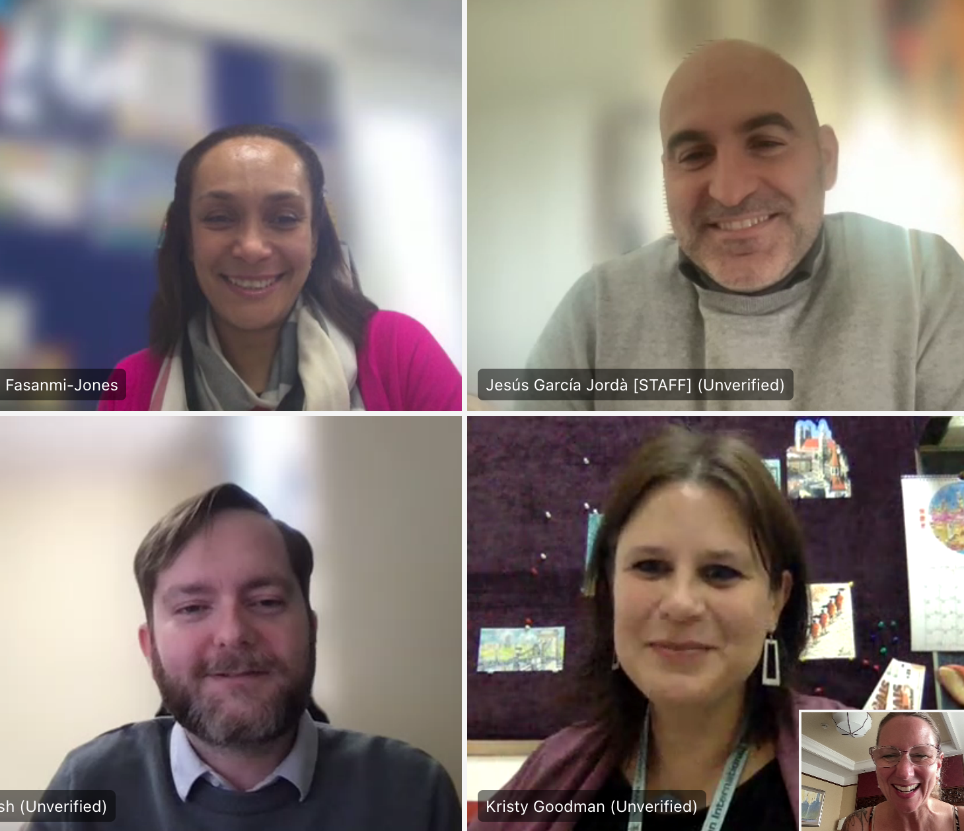
Our Impact
92%
of respondents agree or strongly agree:
“I have learned something from my peers that positively impacted my work.”
of respondents agree or strongly agree:
“Engaging with my peers over the past year has led to valuable learning experiences.”
96%
Peer Coaching Program
"As I prepare to embrace a leadership role next year, the coaching program has been like a compass, guiding me through the complexities of this upcoming role."
– Coachee from the Planning PD Community
"After we asked a series of clarifying questions, we could then ideate with [the coachee] and share our experiences based on a variety of schools where we had all worked."
– Coach from the Global Citizenship Community
Download the Impact Report
© PeerSphere 2024
Notes:
SLIDE 10: Our Impact
ACTIVITY: Share impact highlights.
Note for Facilitator: Invite staff to download and view the impact report during individual/paired work time towards the end of the session.

Slide 11
Our Impact
PeerSphere Communities have been a fantastic addition to professional learning for schools and educators. At a time when schools are aiming to be more inclusive in professional learning and find opportunities for staff who are not traditionally well provided for...We look forward to the expansion of the Communities to include more opportunities for staff in supporting and non-teaching roles.
It is a great opportunity for us to connect with other librarians and hear their experiences - communications with students, promotion of reading interests, and how to combine classroom reading with libraries. Indeed, I was inspired by some of their amazing ideas and implemented some measures to the library.
Being part of PeerSphere is a win for our school.
The communities give us the chance to learn from others and showcase our own practices...We plan to remain connected next year and beyond.
Kasson Bratton
Nanjing International School
Jocelyn Chen
Shenzhen College of International Education
Stephen Taylor
Western Academy of Beijing
Download the Impact Report
© PeerSphere 2024
Notes:
SLIDE 11: Our Impact
ACTIVITY: Invite staff to read testimonials from some of PeerSphere's current partner schools.
Stephen Taylor on inclusive professional learning – equitable and accessible to all staff
Jocelyn Chen on how shared ideas impacted change in practice in her library
Kasson Bratton as year on year continued school partner
Note for Facilitator: Invite staff to download and view the impact report during individual/paired work time towards the end of the session.

Slide 12
How it works?
Click to watch more about your journey with us
© PeerSphere 2024
Notes:
SLIDE 12: How it works?
ACTIVITY: Click on the link to watch about how PeerSphere works. (Video Length: 2:00)
Listen to Michael Iannini talk about the Core Journey with PeerSphere.

Slide 13
TEAMS and SMALL GROUPS
Explore PeerSphere community information
(slides 14 onwards)
2. Have conversations about which community you’d like to join
3. Use the sign-up URL and take a first step to connect with your chosen community
© PeerSphere 2024
Notes:
SLIDE 13: Instructions for Teams and Small Groups
ACTIVITY: The large group can now split up in a two-part next step. Explain that staff will:
1. Work in smaller groups and teams (20 mins):
Explore slide 14 onwards to learn about how PeerSphere works
Ask questions and have conversations about which community you’d like to join
2. Spend time individually or in pairs (20 mins):
Use the sign up URL on slide 18.
Start getting connected with a chosen community.
Have a conversation with a colleague to help make the most appropriate choice.
Note for Facilitator: Before going into small groups and teams, invite thinking about ways to get the most out of PeerSphere ...
School leadership - Consideration of priority communities that can best support school development goals, invite volunteers and allocate to communities.
Teams - Discuss and decide which communities individuals can each join to benefit dept/team collective work.
Teams - Join communities in dyads to support each other bring the learning back into the school.
Individuals – Might want to discuss with appraisers/reviewers to connect a PeerSphere community with individual professional growth processes
Other ideas...?

Slide 14
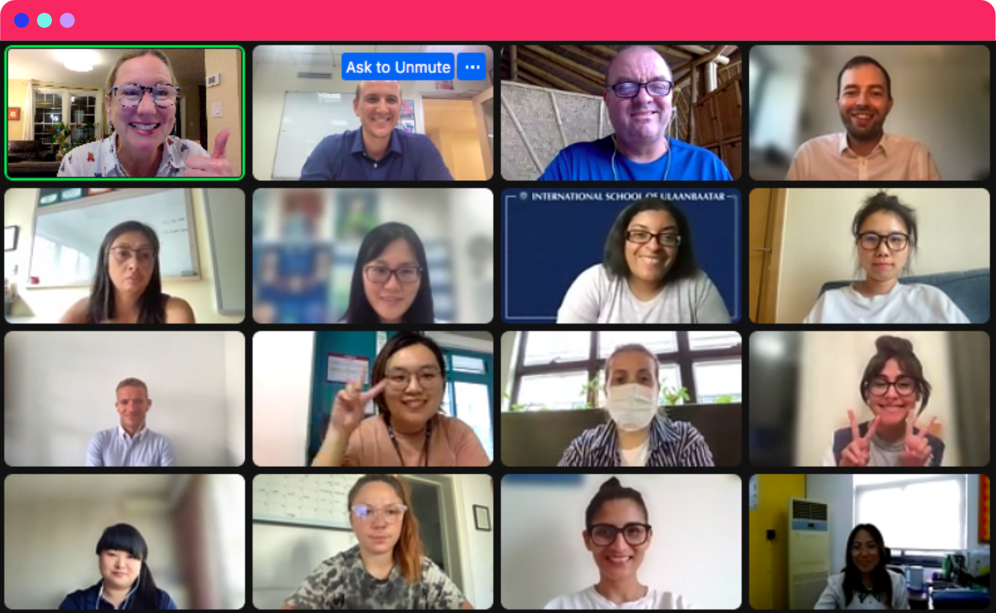
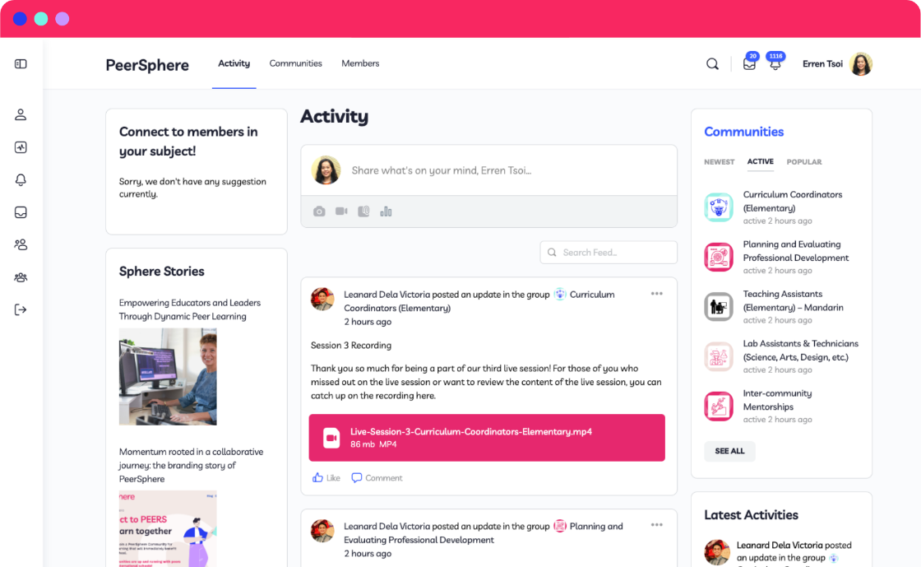
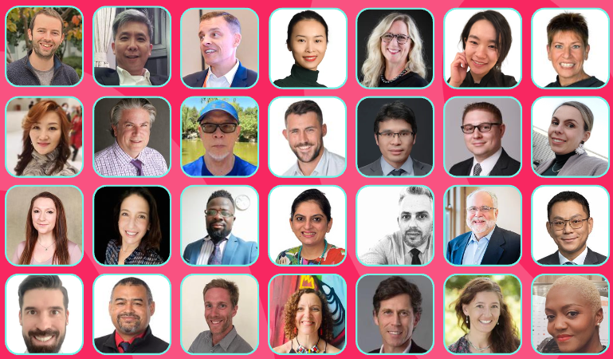
How it works?
Communities to connect and learn…
60+ professionally hosted communities
Professional and experienced hosts
4 virtual 90-min live sessions throughout the school year
+
Click here to Explore all the Communities.
© PeerSphere 2024
Notes:
SLIDE 14: How it works
ACTIVITY: Click on the slide link to explore all the Communities.
The PeerSphere journey …
60+ Communities to choose from – unlimited access for different roles and themes. Example of Middle Leader Commnity = New Middle Leader Community
Regular Virtual Meet-Ups – Four 90-minute live sessions hosted by experts throughout the school year
Free Access to in-person Events – regular in-person topical Peer-to-Peer and hybrid bilingual conferences for various job roles

Slide 15
Your Journey with Us
3. Learn & Grow
Live session 2-3
Learn from others and share your expertise
1. Check-in…
Activation
Check out your community hub, introduce yourself
4. Celebrate
Live session 4
Share your stories of success and shape the future of your community
2. Connect & Engage
Live session 1
Meet your peers & say how and what you want to learn
© PeerSphere 2024
Click here to find out more
Notes:
SLIDE 15: Your Journey with Us
ACTIVITY: Click on the slide link to find out more about the journey.
Your Core Journey with PeerSphere has 4 stages:
1. Check-in…Activation, check out your community hub, introduce yourself
2. Connect & Engage … Live session 1 Meet your peers & say how and what you want to learn
3. Learn & Grow … Live session 2-3 Learn from others and share your expertise
4. Celebrate … Live session 4 Share your stories of success and shape the future of your community

Slide 16
Click to watch what else we include in your membership
© PeerSphere 2024
Notes:
SLIDE 16: There's so much more
ACTIVITY: Click on the link to watch and learn what else is included in your membership. Don't miss out! (Video Length: 2:04)

Slide 17
There’s so much more…
With opportunities to dive deeper …
Peer Coaching
Pair up with another PeerSphere member and apply our coaching model to help you grow
Peer-to-Peer Events
Face to face events every month in cities across China and East Asia
Inter-community Webinars & Networking
Hear from experts on important topics and connect with peers from all of our communities
Conferences
Free virtual access to conferences for Teaching Assistants and Non-Teaching Staff
© PeerSphere 2024
Notes:
SLIDE 17: There's so much more
ACTIVITY: Read more about further opportunities ...
Peer Coaching: November to May (more info: https://www.peer-sphere.com/peer-coaching/)
Peer to Peer Events – monthly in cities across China and East Asia (more info: https://www.peer-sphere.com/peer-to-peer-events/)
Conferences – free virtual access to conferences for Teaching Assistants and Non-Teaching Staff (more info: https://www.peer-sphere.com/hybrid-conferences/)
Intercommunity networking events & webinars – expert input and peer discussions

Slide 18
Get Started!
Forward email with School Member Activation Link to staff
Link: Members Handbook
Deadline for signing in: Wednesday 10th October
© PeerSphere 2024
Notes:
SLIDE 18: Get Started!
ACTIVITY:
Use the link to access the members handbook.
Use your school's unique sign-in URL to get connected in PeerSphere BEFORE (date).
Reflect and share:
What excites you about the journey ahead with Peer Sphere? Two things.
What challenge might you forsee with the journey ahead? What can you do in advance to overcome this? One thing.
What will you do as a result of the PeerSphere learning journey? Make one commitment.
Note for Facilitator: Add the date by which you would like all your school staff to have signed in to their PeerSphere community.

Slide 19
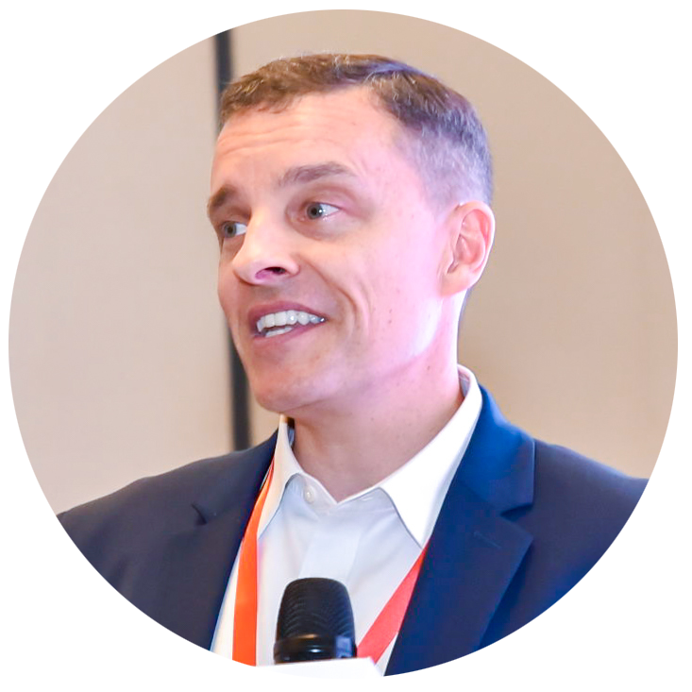
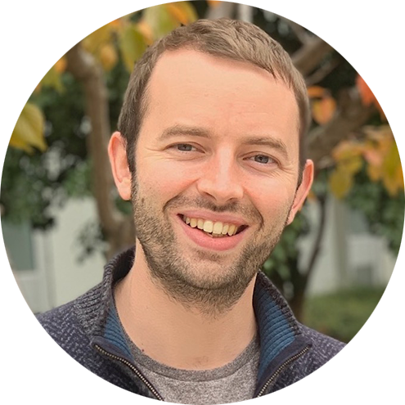
About Us
Michael Iannini
ACAMIS’s Leadership Development Facilitator
Search Associates Contracted HR PD Coordinator for China
Affiliated Council of International School’s (CIS) consultant
Areas of expertise: Appraisal and professional development, Leadership training, School governance, and Strategic planning.
Ewen Bailey
Education Consultant, PD Academia
Professional Development and Learning expert
Experienced international leader in education who supports teachers and leaders to build resilient, collaborative teams that focus on continuous improvement
Find out more
© PeerSphere 2024
Notes:
SLIDE 19: About Us
ACTIVITY: Click on the link to find out more about PeerSphere Co-Founders, Michael Iannini and Ewen Bailey.

Slide 20
Peer Learning Research
Read about the power of peer learning
How Research Shows Peer Learning is Effective PD read on (PeerSphere)
The Buzz about Peer Learning read on (PeerSphere)
4 steps for Creating Stronger, More Collaborative Teacher Teams read on (ASCD)
The Power of Peer Learning: A Budget-Friendly, Sustainable and Dynamic Approach for Professionals read on (Forbes)
Reconfiguring Teacher Collaboration read on (Education Development Trust)
Check out more stories on our Blog
© PeerSphere 2024
Notes:
SLIDE 20: About Us
ACTIVITY: Click on the links to read more about the power of peer learning.

Slide 21
Thank you!
© PeerSphere 2024
Notes:
SLIDE 21: Thank you!

